Slide 1
The Flood of the Century
Red River Valley, Southern Manitoba
Spring 1997

Slide 2
Lesson 1
Water on Earth
Slides # 3-14

Slide 3
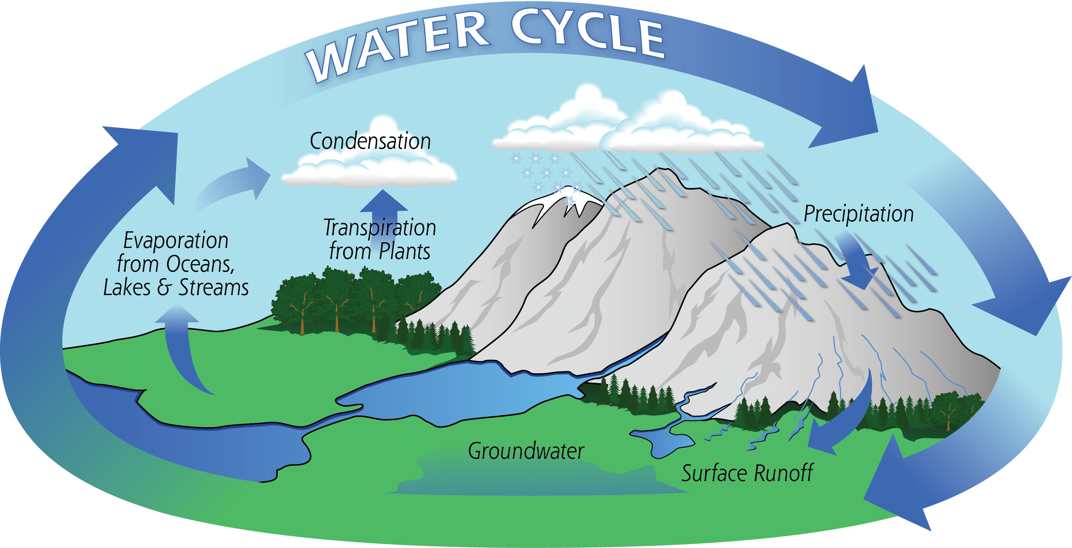

Slide 4
Distribution of water in the world
Water Type | Percent
Fresh | 3 %
Salt | 97 %

Slide 5
The Difference Between Fresh and Saltwater
The average salinity (saltiness) of ocean water is 3.5 percent which means that 35 grams of salt dissolve in a liter of seawater. The salinity of different bodies of water prevent organisms from thriving in both salt water and fresh water. Some plants and animals survive in one type of water but not the other.
Another considerable difference between the two is their density. Salt water has a higher density than fresh water because of the sodium chloride it contains. Furthermore, cold salt water is denser than warm salt water, but it becomes less dense when water freezes into ice. The boiling point of seawater is higher than that of pure water, and its freezing point is lower. The density of salt water is 1.025, while fresh water’s density is 1.0. Objects float more easily in salt water than in fresh water. Humans typically find it easy to float in seawater but not in fresh water.

Slide 6
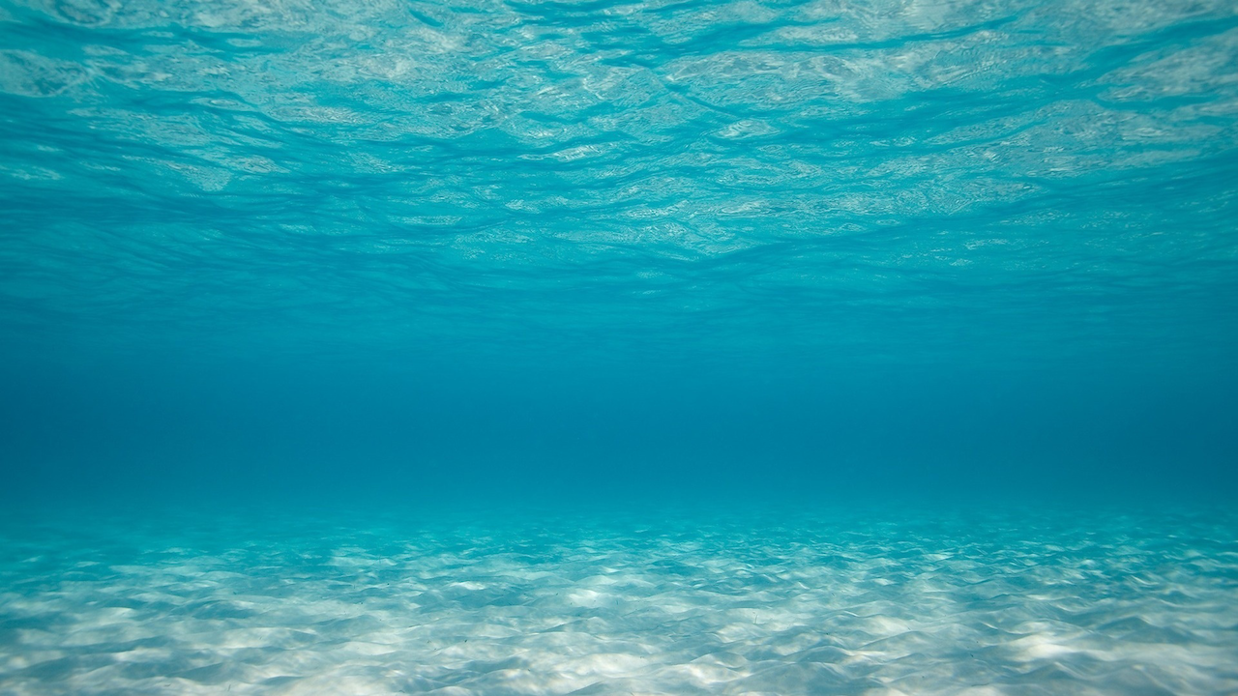
Warmer and Less Salty
Colder and Saltier

Slide 7
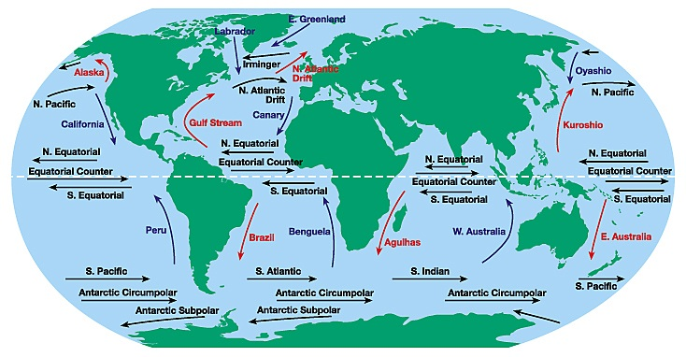
Differences in Saltiness and warmth helps to create ocean currents

Slide 8
You might remember one famous ocean current

Slide 9
Distribution of Surface Water
Source | Percent
Icecaps and Glaciers | 68.7 %
Groundwater | 30.1 %
Atmosphere | 0.9 %
Surface Water (Lakes, Rivers, Swamps) | 0.3 %

Slide 10
Distribution of Earth’s Surface Water
Source | Percent
Lakes | 87 %
Swamps | 11 %
Rivers | 2 %

Slide 11
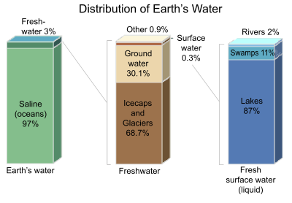

Slide 12
Only 1% of the earth’s water is usable
We rely on groundwater and surface water

Slide 13
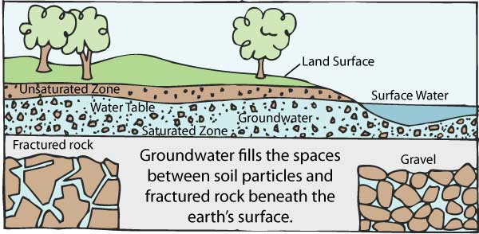

Slide 14
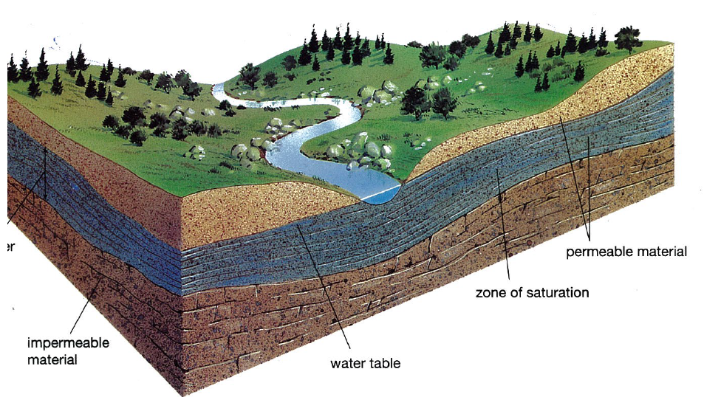
Groundwater

