Slide 1
Lesson 2
The Red River Valley
Slides # 16-28

Slide 2
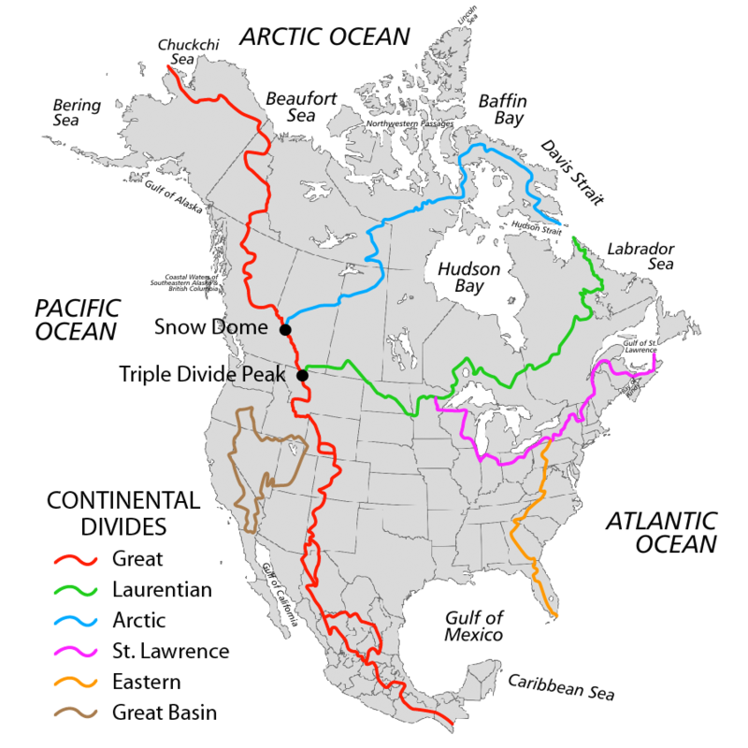
Drainage Basins of
North America
We are here, in the
HUDSON BAY
Drainage basin

Slide 3
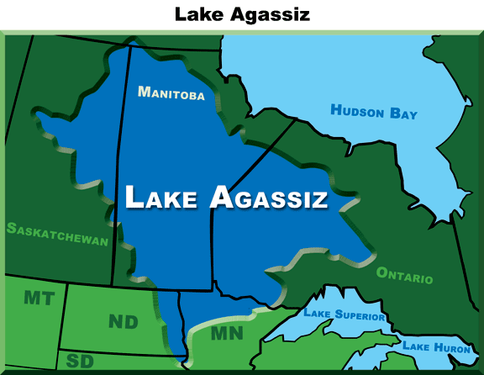
Most of Manitoba is the bottom of ancient Lake Agassiz which formed when the glaciers melted 9500 years ago.

Slide 4
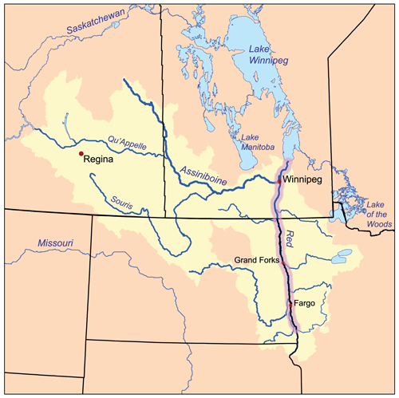
The Red River Valley
All waters empty into the Red River

Slide 5
The Red River begins on the border of Minnesota and North Dakota where the Bois de Sioux and Otter Tail Rivers meet in Breckenridge, Minnesota
It flows northward to Manitoba and empties into Lake Winnipeg, whose waters join the Nelson River and ultimately flow into Hudson Bay.
The Red River is 885 Km long: 635 Km are in the US and 250 Km in Canada
The river falls 70 meters on its trip to Lake Winnipeg. It spreads into the Lake at the huge delta wetland known as Netley Marsh.
The Red River was an important highway for trade.

Slide 6
Rivers that start on high ground are called “YOUNG” rivers. They are steeper, flow faster, are straighter, narrower and have more shoreline erosion. The sediment that is deposited is larger in size (pebbles, stones and larger rocks) because the water has more energy.
Rivers that flow on lower ground are called “OLD” rivers. They are less steep, flow slower, meander (curve), are wider and have less shoreline erosion. The sediment that is deposited is smaller in size (sand and clay) because they have less energy.
The Red River is an “OLD” river.
The Red River commonly floods in the spring. Major floods have occurred in 1826, 1897, 1950, 1997, 2009, and 2011.

Slide 7
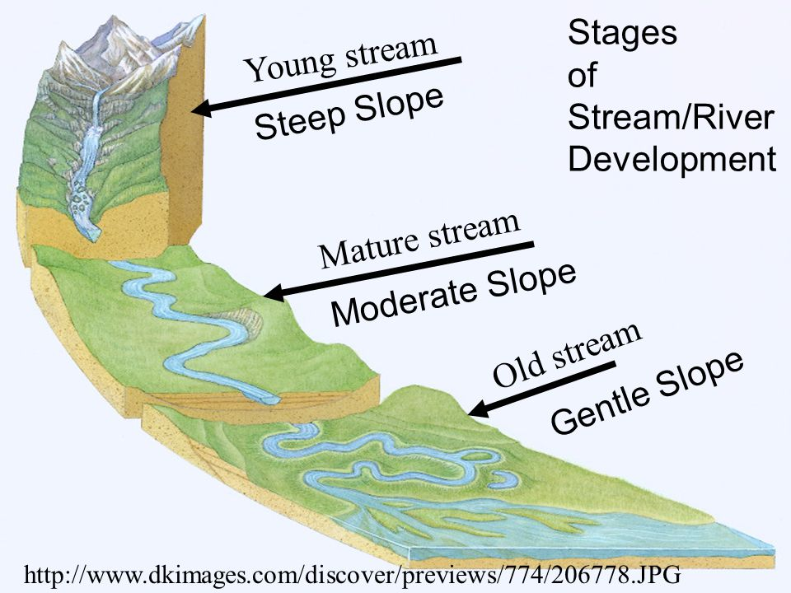

Slide 8
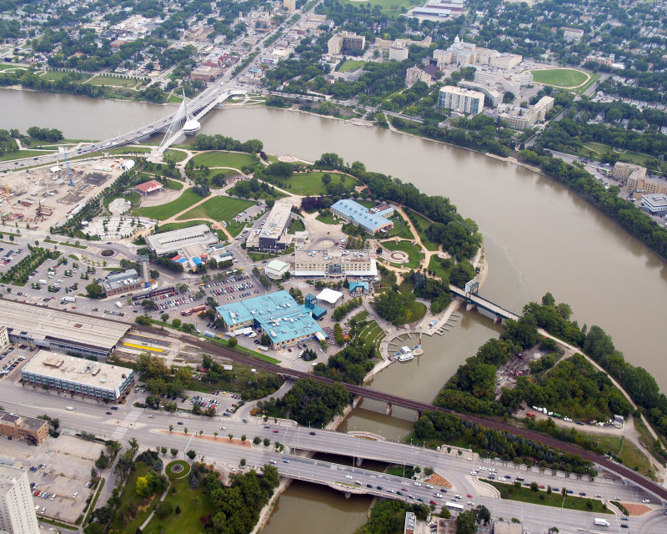
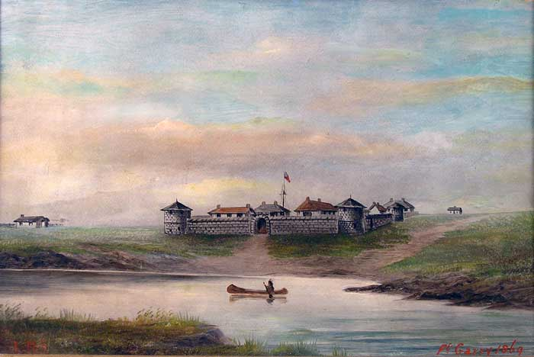
The Forks – where the Red and Assiniboine meet

Slide 9
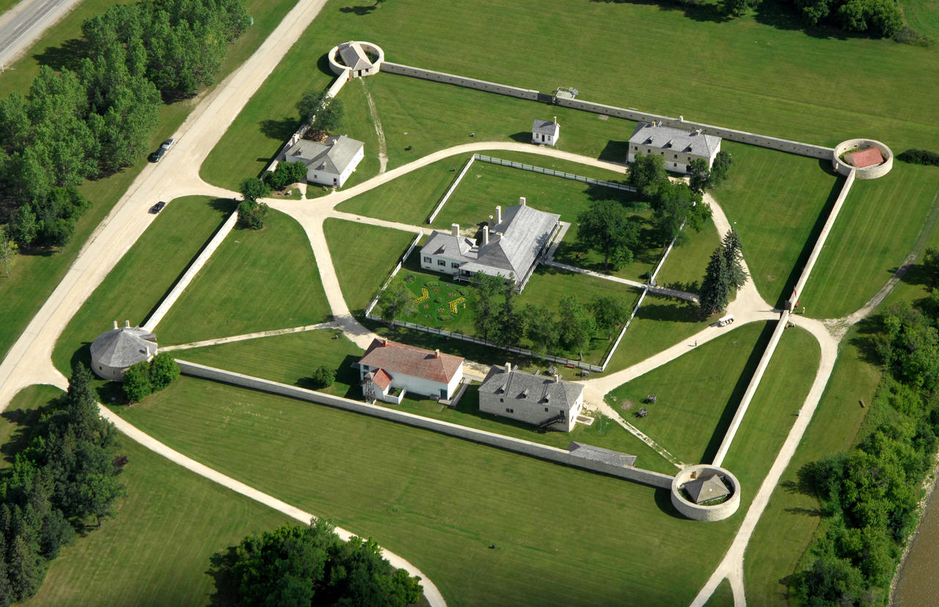
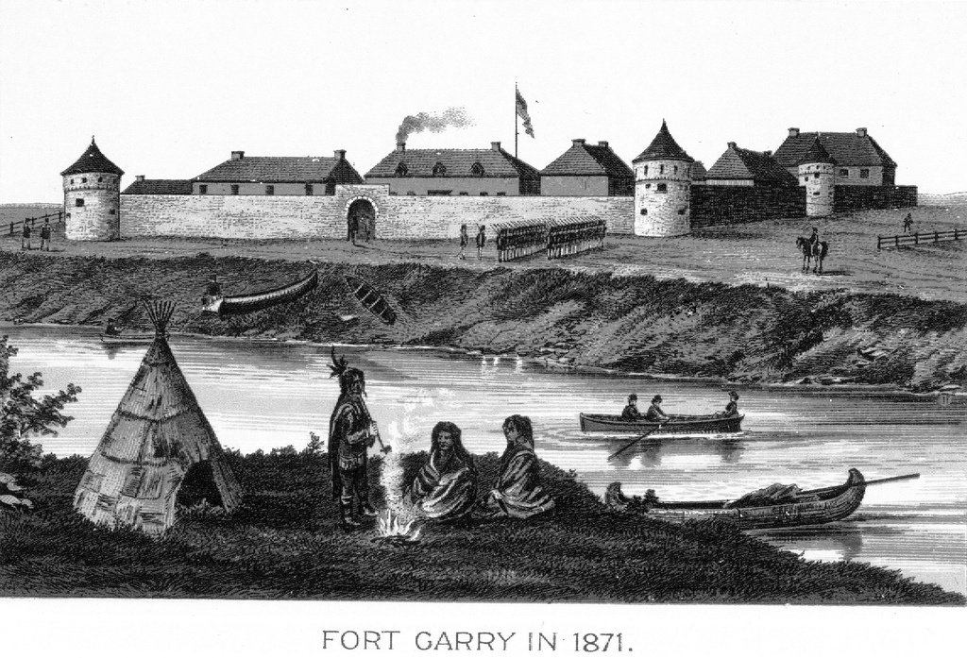
The original Upper Fort Garry was located near the Forks but it was destroyed in 1826 by a flood. Governor George Simpson rebuilt Lower Fort Garry in 1830 at the current location because it was on higher ground and was past the St. Andrews Rapids (Lockport).

Slide 10
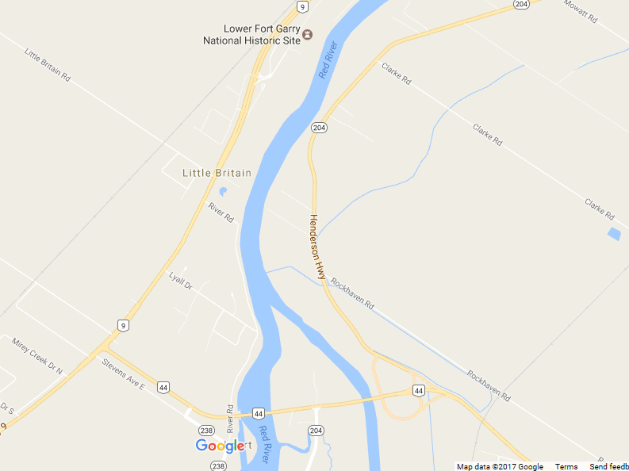
The St. Andrews rapids were located near the current day “Lockport Bridge”.

Slide 11
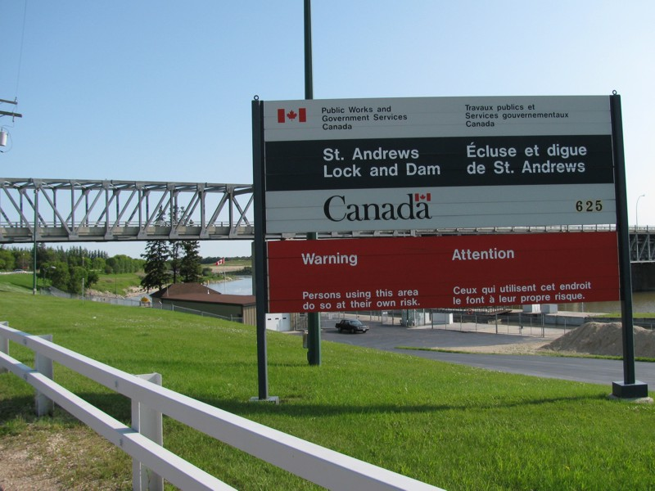
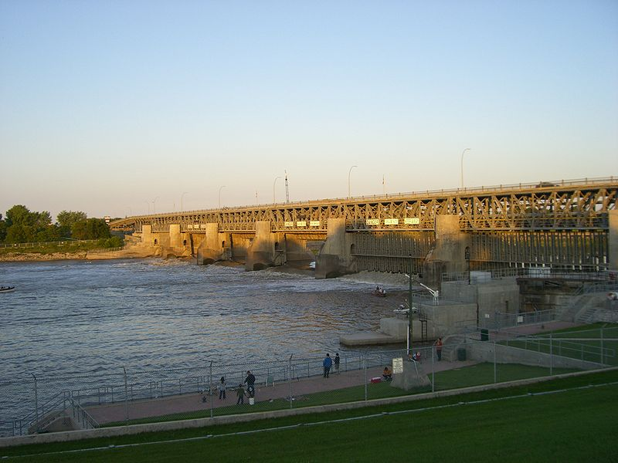
Why is the Lockport Bridge also called the St. Andrews Lock and Dam ?

Slide 12
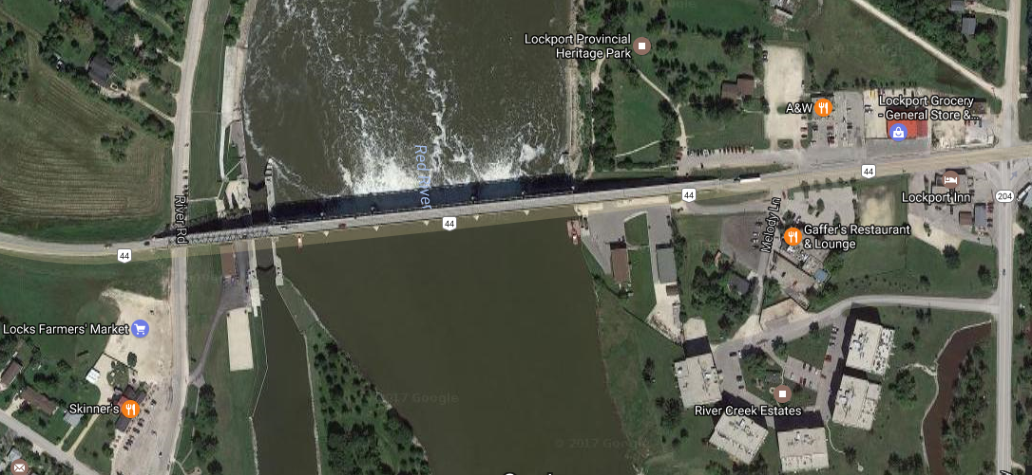
Dam – Wooden curtains below the roadway can be raised to block water flow and raise water levels downstream. Why ?
LOCKS – water level can be raised or lowered between the locks

Slide 13
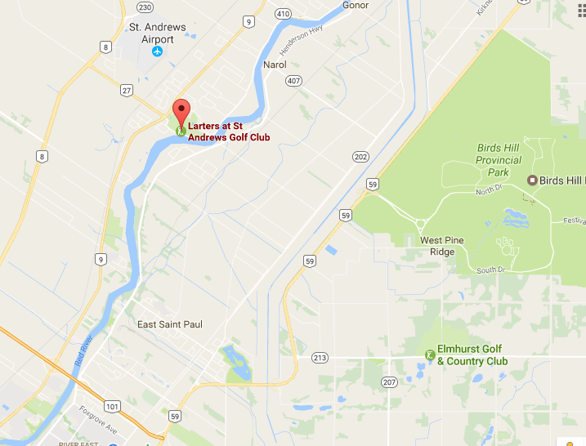
There are a series of low-lying rapids between North Winnipeg and Lockport. Without the dam, boats can’t navigate along the Red when the water level is low (late summer and fall).
Lock and Dam Video

Slide 14
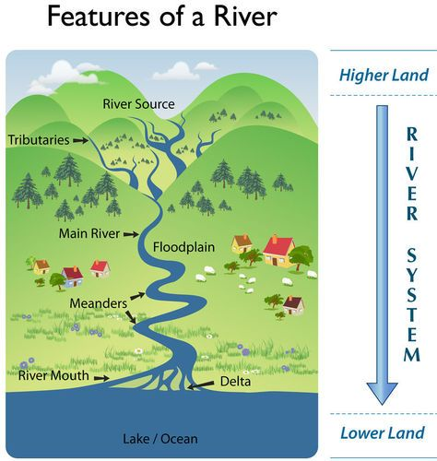
Would you build your house on the outside curve of the meander (A) or the inside curve of the meander (B) ?
B
A
Video 1
Video 2

