Slide 1
Shape and Space Lesson 1
Building a Cube

Slide 2
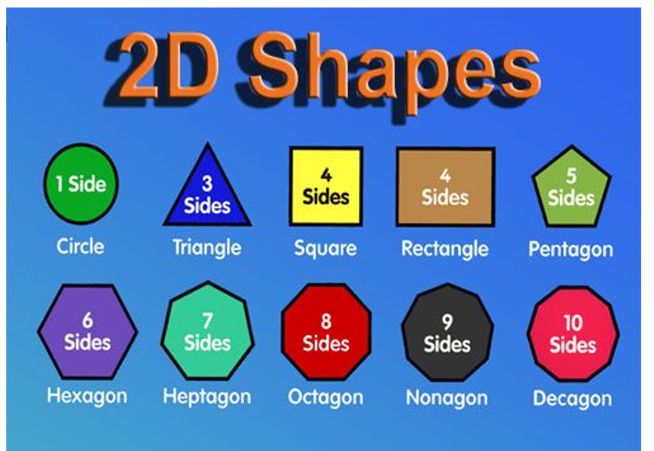
Have Length and a Width
Are often called a “flat” shape
Have length, width and height
Are often called a “solid” shape

Slide 3
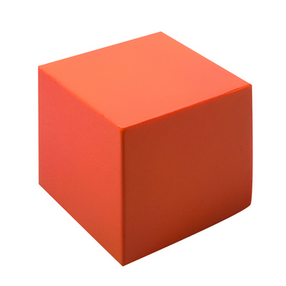
Assignment #1
Design a 2-D shape that can be folded or bent into a 3-D Cube.
You can use blank paper, poster paper or cardboard
Take a picture of your 2-D shape and your assembled 3-D cube and e-mail them to your teacher

