Slide 1
Review of Lesson 1
Building a Cube

Slide 2
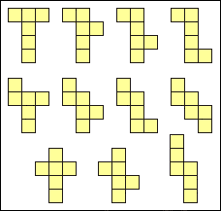
The 11 nets of a cube

Slide 3
Watch how each net folds into a cube

Slide 4
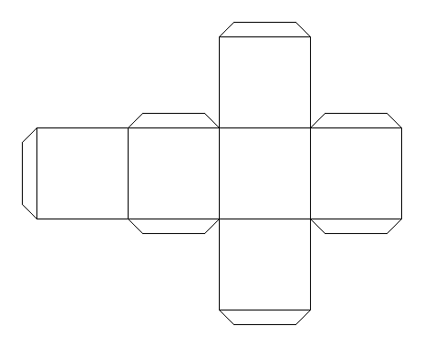
Adding TABS to your net make it easier to assemble.
Tabs

Slide 5
Shape and Space Lesson 2
Building 3 More Right Prisms

Slide 6
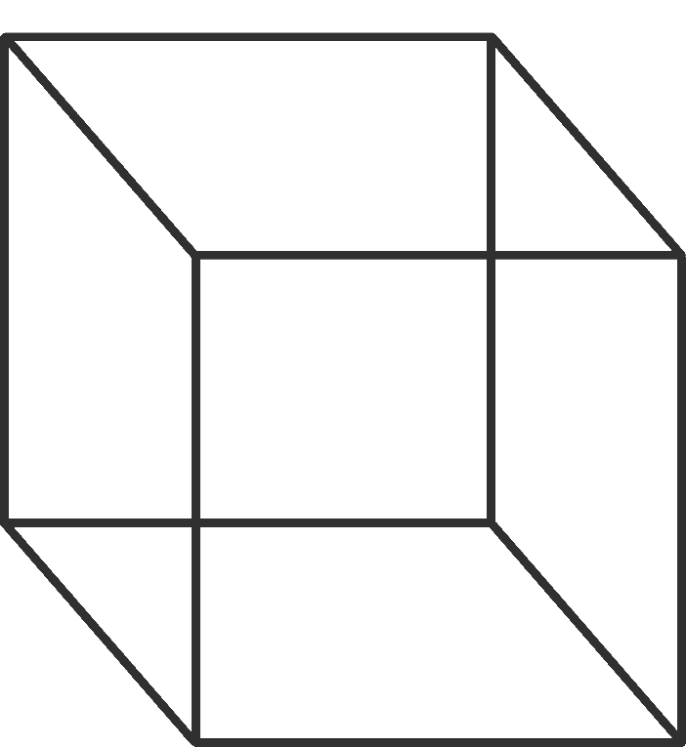
Front side
What is a Right Prism?
A 3-D shape where the front and back sides are the identical shapes
Back side
Cubes are Right Prisms

Slide 7
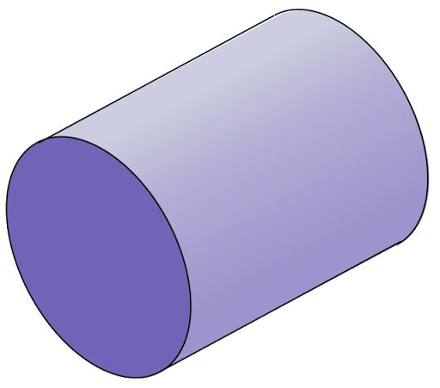
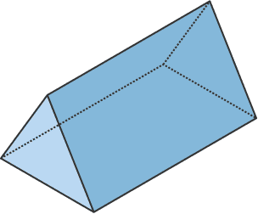
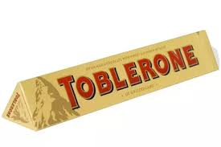
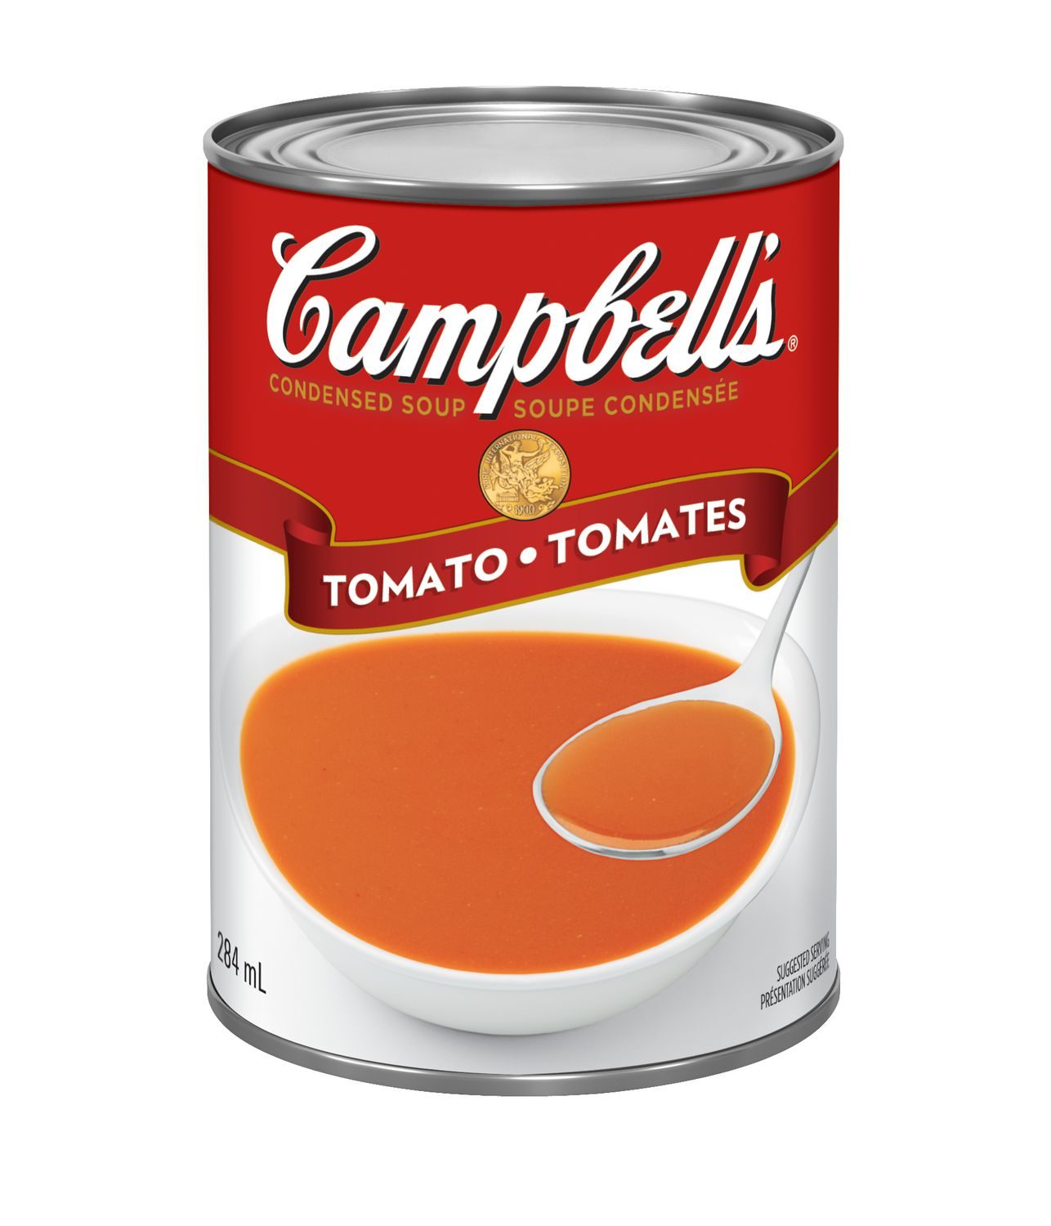
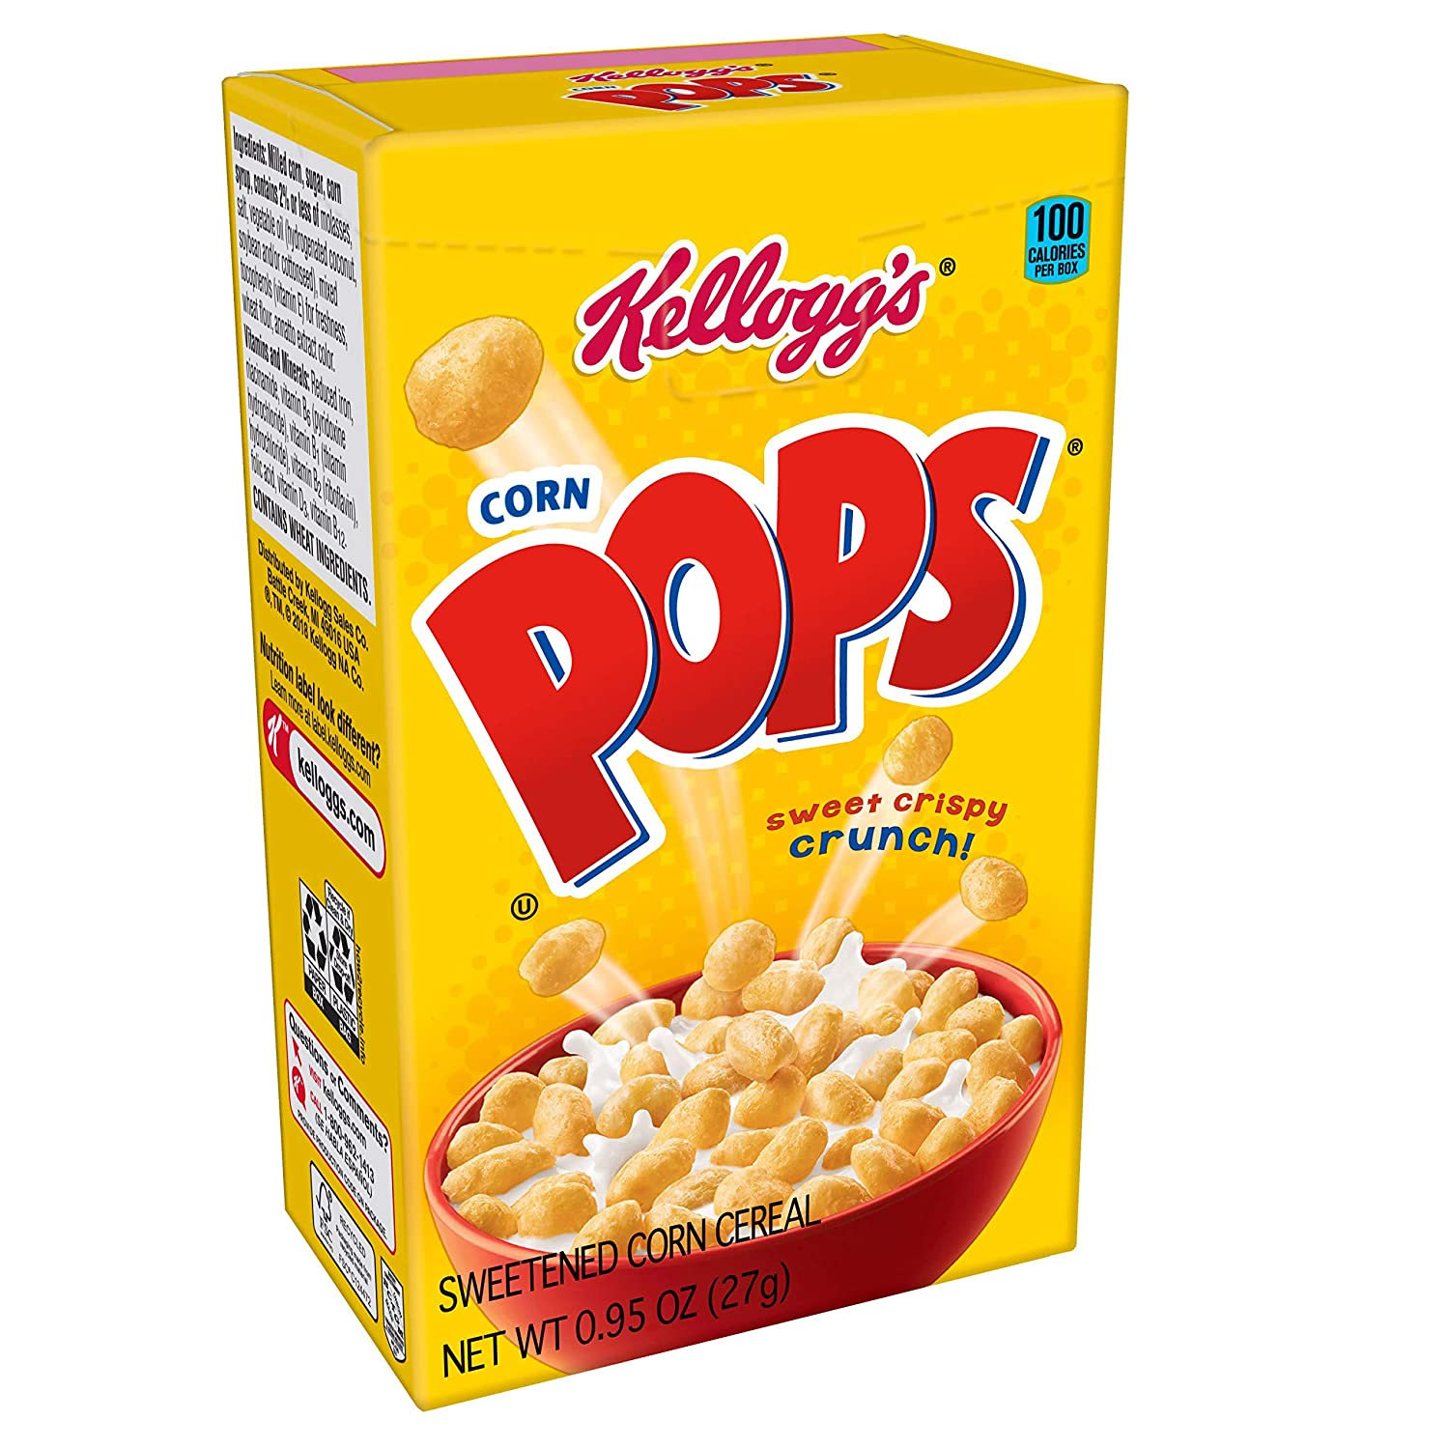
Rectangular Prism
These are also Right Prisms
Triangular Prism
Cylinder

Slide 8
Rectangular Prism
Assignment #2
Design a 2-D shape that can be folded or bent into each prism below.
Take a picture of your net and the assembled prism and e-mail them to your teacher (as one file).
Cylinder
Triangular Prism

